Slide 1














Student Loan Debt and Average Starting Salary After 4 Year University Completion

Slide 2

Extract, Transform, Load
Extract
We used 2 csv files: 1 on student loan debt and1 on average salary from highest ranked schools
Transform
We cleaned the csv files using pandas and python
Load
We loaded the final data frames to SQL using sqlalchemy engine and joined into one table

Slide 3
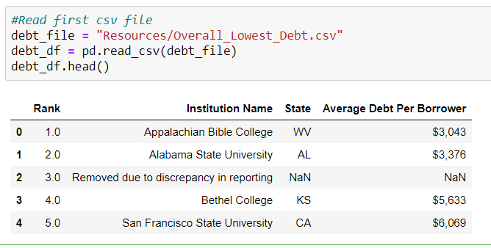
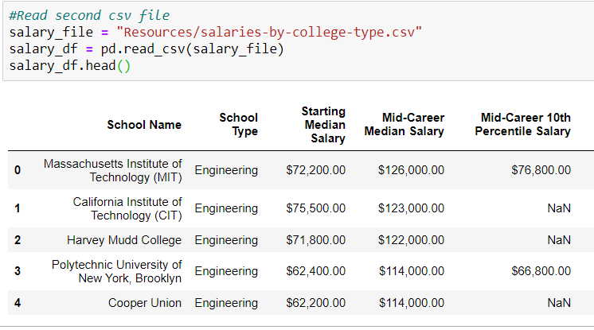
Extract Data from CSV Files & Create Dataframes
CSV File 1
CSV File 2

Slide 4
Transform the Data and Join
Data Cleaning
We dropped NaN rows and columns we didn’t need for this analysis
Filtering
Aggregating

Slide 5




Load
We then loaded the data into SQL and used
for future analysis or business use.
Summarization
Joining
Creating SQL queries
Load

Slide 6
Analysis: We will join the two data sets on the university name to compare student loan debt versus the average salary after graduation.

